Slide 1
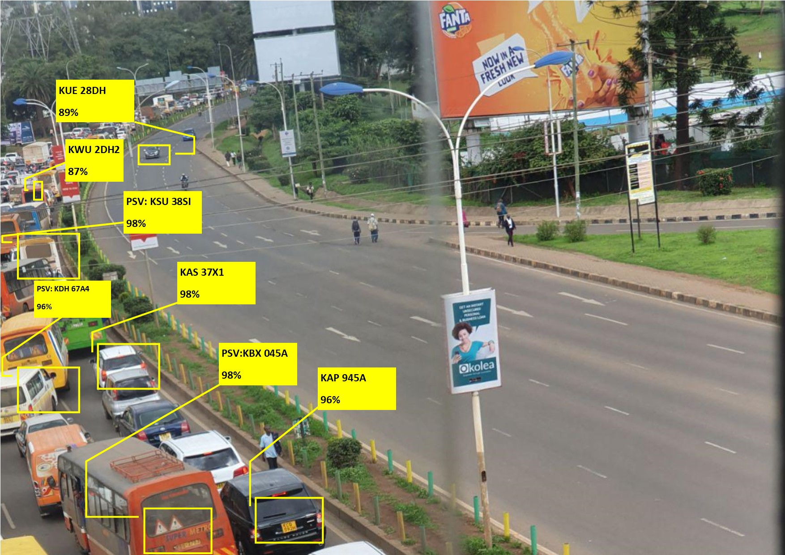
IMPROVING ACCESSIBILITY AND EFFICIENCY OF PSV(public service vehicles) INSURANCE.
Author: Stanley Sayianka Saitet

Slide 2
Based on research, studies and analyses that I read focusing on PSV insurance in Kenya and the challenges it faces, the major conclusions I obtained are outlined below: 1. Weak enforcement of traffic laws – Due to this, there exists incessant violation of these rules by PSV drivers and conductors. This usually leads to enormous cases of road accidents which has a ripple effect of increasing liabilities to insurance firms. 2. Fraudulent claims.(fraud aided by lawyers, claimants and medical personnel), This leads to reduced profits by insurance firms. 3. The lack of integrated data system on PSV insurance. – Lowers the confidence/interest/capacity of insurance firms to accept such risks. Due to the challenges faced by insurance companies in insuring PSV risks, it leads to many insurance companies avoiding PSV risks and thus the insurance market on PSVs is only left with few insurers, which scares off investors, saccos, and organizations willing to partner and venture into the PSV business
Problem
Notes:
Moral hazards-human characteristics which lead to exaggerated losses.

Slide 3
In order to combat the mentioned challenges and thus improve the willingness of insurance companies to accept PSV risks, an insurance company can adopt a system of surveillance on roads, especially on roads and streets where the PSV(matatus) operate, or on high claim-frequency spots. These surveillance systems(using CCTVs), will ensure real time monitoring of PSVs, stepping up in the place of weak enforcement of traffic laws as well as enabling insurance companies to have evidence in proving/disproving liabilities and challenging validity of claims. The data obtained from the surveillance cameras can also be used in monitoring the behavior of PSVs or drivers, such as over speeding, careless driving and over-taking, and over-loading passengers, and over-lapping on roads. In this surveillance system, it will be expensive to actually hire individuals to monitor the video footages of cars on streets and high ways, but an alternative exists, we could employ pattern recognition models(Deep learning algorithms) to aid in extracting information from the massive data obtained from video footages. Due to the advances in computing power, and the increase in processing power of computers(using GPUs), these models can sieve through massive amounts of data from the surveillance cameras in considerable time. The data obtained from the networks of surveillance cameras, can be uploaded in real time, or sequentially in batches to cloud infrastructure, where the model will sieve through the data in order to extract meaningful information. Information we desire to get from the data includes: 1. The car number plate to act as the primary key in the central database. 2. Information regarding the state of the car i.e over-speeding, over-loading, or dangerously driven.
Solution

Slide 4
1. Weak enforcement of traffic laws – This system could possibly lead to a positive reactivity or Hawthorne effect among drivers, since when PSV drivers are made aware that their behavior is monitored real-time, It could possibly create the effect of observing traffic laws, avoiding over-speeding and over-loading, and avoiding fraud during claiming process at all. This is because they will be made aware that every mistake they make on roads will affect their claiming process, premium loading and general rating. 2. Fraudulent claims. – This system, will be able to track and record all cases of accidents that occurred in the spots where the surveillance cameras are placed, thus the insurance companies will have sufficient evidence in proving or disproving liability. This will make drivers, and PSV owners more honest regarding claiming, since frauds could affect their insurance policies and even future policies they will seek to undertake. 3. The lack of integrated data system on PSV insurance – Due to the adoption of this system, there will be a common central database that could be shared among the insurance sectors issuing PSV insurance. It will make the process of tracking the insured PSVs, monitoring their behavior, and assessing PSV risks easier. A centralized motor insurance data system would aid in the consideration of insurance firms to underwrite PSVs and this will revive the PSV insurance market, and lead to an uptake of this businesses by major investors and organizations
Impact/ Challenges solved
The Hawthorne effect occurs when people behave differently because they know they are being watched. Reactivity is a phenomenon that occurs when individuals alter their performance or behavior due to the awareness that they are being observed. The change may be positive or negative, and depends on the situation.
Notes:
The Hawthorne effect occurs when people behave differently because they know they are being watched. Reactivity is a phenomenon that occurs when individuals alter their performance or behavior due to the awareness that they are being observed. The change may be positive or negative, and depends on the situation.

Slide 5
When such data on PSVs becomes available to an insurance company or the insurance market in Kenya, then challenges associated with PSV insurance such as weak enforcement of traffic laws, fraudulent claims, challenges in claims and policy renewal and lack of an integrated data infrastructure on PSVs would be solved. Insurance companies would then be interested in the PSV market once again, and this would ensure active under-writing of PSV risks in Kenya. This would lead to an increase in the uptake of PSV business in the Kenyan market. This would further improve ease of access of PSV insurance to major PSV saccos and individual owners due to the booming PSV insurance market.
Market
Partnerships
The insurance company willing to adopt this system could get partnership from bodies such as:
1. NTSA(National Transport and Safety Authority) 2. The Traffic Police Authority 3. The Insurance Regulatory Authority of Kenya(IRA) 4. Other insurance companies willing to partner and be part of the system. 5. The government as well, since this system will also help in monitoring safety in roads, and safety of citizens.

Slide 6
The following steps could be used by the models: 1. The footages are fed(uploaded) on a sequential basis to the model, or real time depending on choice of interest. 2. The model scans the frames in the footage and identifies objects of interest(cars). 3. From the objects identified from a particular frame of the footage, the model tries to employ text recognition algorithms to obtain the number plate of the cars and then uses the number plate to lookup whether it is an insured PSV and if yes, it creates a record for the car in a centralized database in the cloud or on a block chain facility. 4. The model then judges(based on calculated logic, and metrics) whether, the particular object(car) was over-speeding, over-loaded, or being dangerously driven(over-lapping). This will be explained in detail below. 5. The central database is then updated each time the car number plate is observed from the footage. 6. For accidents, then it would need intervention of individuals, to watch the footages and identify whether the car(of interest) was on the wrong, (such a task is hard for models)
Model work

Slide 7
DATA
MODEL
010
101
011
ST RAGE
INFORMATION
DECISION

Slide 8
A car is observed driving in Lane 14A, The model identifies: 1. That the car is a PSV (for the sake of example number plate KCD 037D). 2. The car is over-loaded and driving on the wrong lane. 3. The car is over-speeding, based on the speed limit on this street and speed is approximately calculated by distance observable by the surveillance camera divided by the number of seconds elapsed when the car is in motion on the observable range of the camera. 4. Based on the road, the car is being driven on the wrong lane, and that it is over-loaded (passengers hanging on the door side-a common trait of Kenyan matatus) 5. The model captures all this data, and creates a new record as shown below. 6. In case of claim processing, we will first have to analyze records and view all entire records of this particular car, to assess its general behavior on road based on its appearances on our records, and thus pay claims accordingly or alter premiums accordingly.
Case scenarios
1
Day | Month | Year | Car ID | Location | Time in | Time out | Approx speed | Overlap | Overload | Frame
21 | March | 2021 | KCD 037D | Lane 14A | 12:07:45 | 12:08:23 | 67 mps | YES | YES | 218s
An insured PSV, comes to process a claim and states that an accident just occurred last night or such as the car was stolen, and the police arrived late(or something which could be of an excuse). If the car happened to pass on a street with our surveillance system, then we will be able to do a simple search and see when the car passed e.g: The driver claims the accident occurred around 12:00, there is no record which matches with that, then this could be termed as fraud on the side of the insured or: The driver was noted to over-speed, before he/she was involved in an accident, then a penalty will be charged since it could be that over-speeding was the cause of accident.
2

Slide 9
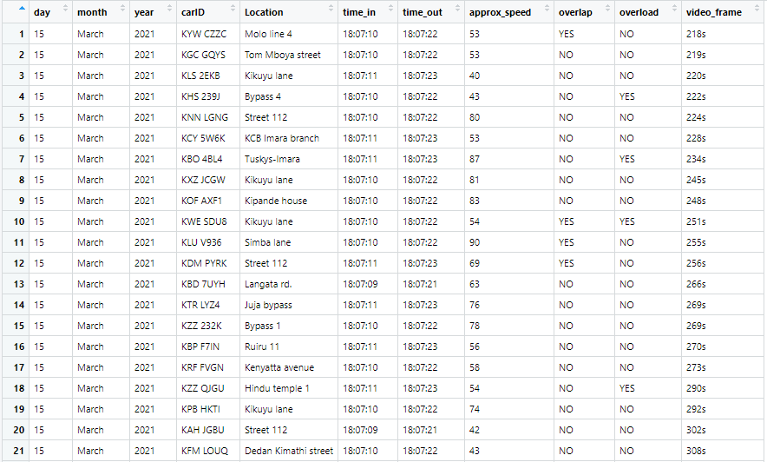
Sample data that could be stored
Variables of interest:
1. Day
2.Month
3. Year
4. Car number plate
5. Location observed
6. Time first seen
7. Time last seen on footage
8. Approximate speed
9. Was the car overlapping or being driven in wrong lane
10. Was the car over-loaded
11. Particular video frame-for later evidence

Slide 10
An insurance company willing to employ this system, will not require to install its own surveillance cameras, since on major highways(where PSVs operate), the government transport authority has already installed high quality surveillance cameras on major roads. Along major roads where big buildings are situated e.g. banks, they also could be having surveillance cameras which could be facing major roads of interest, and this could be of great help to the insurance company. The insurance company could liaise/get some permission from the buildings with CCTV cameras of interest or the National Transport Authority.(in charge of surveillance cameras in major high ways) They do not necessarily need to get copies of video footages, e.g. if the NTSA uploads the video footages to a certain cloud storage such as Google cloud, we would only need to be granted permission to access the videos(with “read-only” permission, and that would be enough).
Feasibility of the system
1
The frameworks that would be involved in the work of extracting information from data footages and updating our records based on the data are freely available such as: 1. OpenCV – an open source computer vision library 2. Tensorflow – Google’sopen source Machine learning framework 3. Tesseract – an open source text recognition engine 4. Azure and AWS – These are cloud infrastructure from Microsoft and Amazon respectively, they allow deployment of models to the cloud infrastructure and also allows companies/individuals to use their GPUs(processing units), and progress can be monitored real time. They are not free but have manageable monthly subscription fees. All these libraries/services are available in open source programming languages such as python and R, and come with ready made templates, to assist in model development, I am in the process of making a sample model, and share its working. The model can then be deployed to the cloud, where it would go on with its work.
2

Slide 11
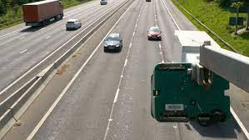
ESTIMATING APPROXIMATE SPEED
10 metres
Eye view
Speed=Distance/time
e.g. 10 metres/3 seconds=3.33 mps

